Slide 1
Video 1: Error Definition

Slide 2
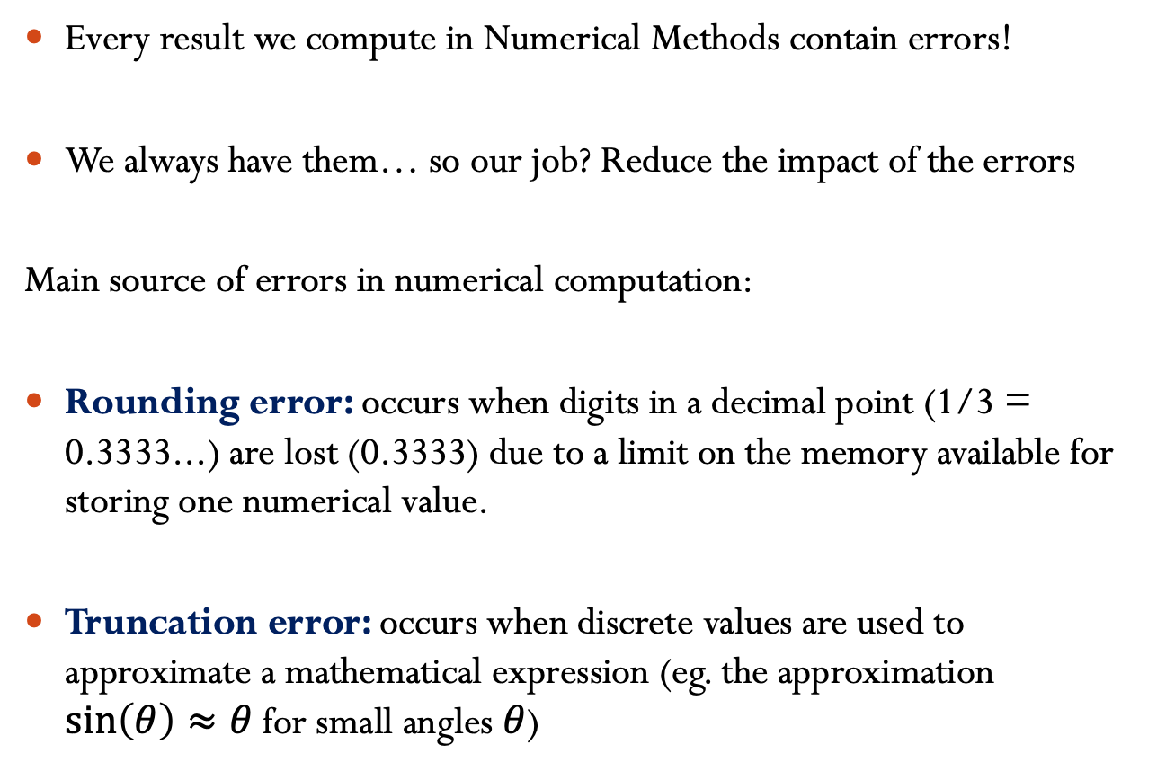
Errors in Numerical Methods
Every result we compute in Numerical Methods contain errors!
We always have them… so our job? Reduce the impact of the errors
Main source of errors in numerical computation:
Rounding error: occurs when digits in a decimal point (1/3 = 0.3333...) are lost (0.3333) due to a limit on the memory available for storing one numerical value.
Truncation error: occurs when discrete values are used to approximate a mathematical expression (eg. the approximation $\sin\left(θ\right)≈θ$ for small angles $θ$)

Slide 3
Evaluating the Error
How can we model the error?
Absolute error:
Relative error:
Notes:
Every result obtained from a Numerical Method contain errors. So since we cannot avoid the errors, our job is to better understand where they come from, such that we can reduce their impact.
How we will model the error? We will define the approximated result x hat as the summation of the true value x plus the error delta x.
The absolute error is defined as the absolute value of the difference between the true value and the approximated value
The relative error is the absolute error divided by the absolute value of the true x.

Slide 4
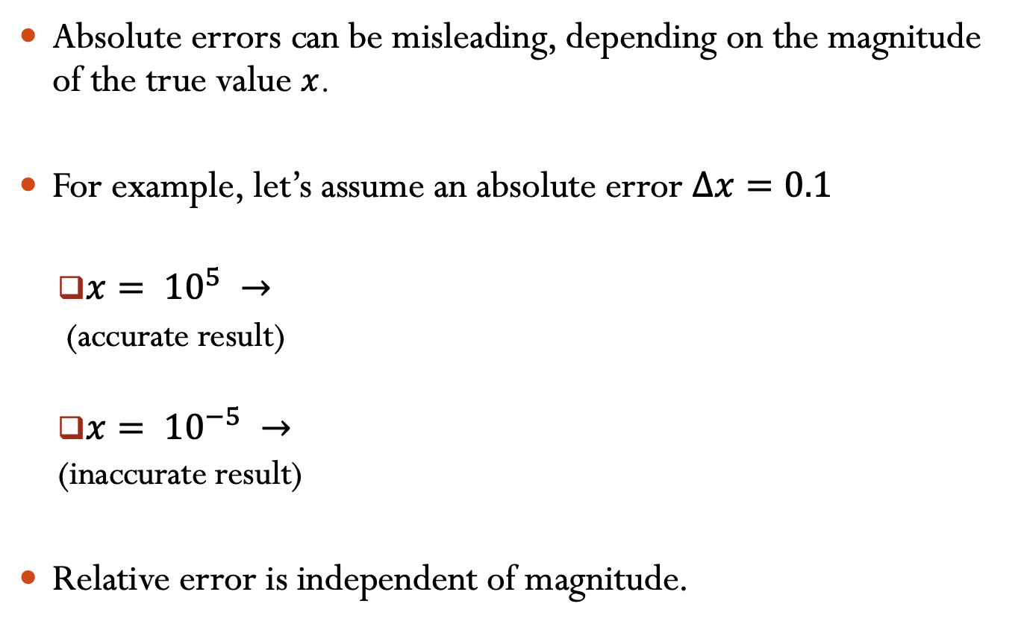
Absolute errors can be misleading, depending on the magnitude of the true value $x$.
For example, let’s assume an absolute error $∆x=0.1$
$x= {10}^{5} →$
(accurate result)
$x= {10}^{−5} →$
(inaccurate result)
Relative error is independent of magnitude.

Slide 5
You are tasked with measuring the height of a tree which is known to be exactly 170 ft tall. You later realized that your measurement tools are somewhat faulty, up to a relative error of 10%. What is the maximum measurement for the tree height?
Notes:
Talk about why |xo| - |xbar| is not a good way of measuring error.
Answer is 187 (C

Slide 6
You are tasked with measuring the height of a tree and you get the measurement as 170 ft tall. You later realized that your measurement tools are somewhat faulty, up to a relative error of 10%. What is the minimum height of the tree?
Notes:
Answer is 155 (B)

Slide 7
Video 2: Significant Figures

Slide 8
Significant digits
Significant figures of a number are digits that carry meaningful information. They are digits beginning to the leftmost nonzero digit and ending with the rightmost “correct” digit, including final zeros that are exact.
The number 3.14159 has _____ significant digits.
The number 0.00035 has _____ significant digits.
The number 0.000350 has ______ significant digits.

Slide 9
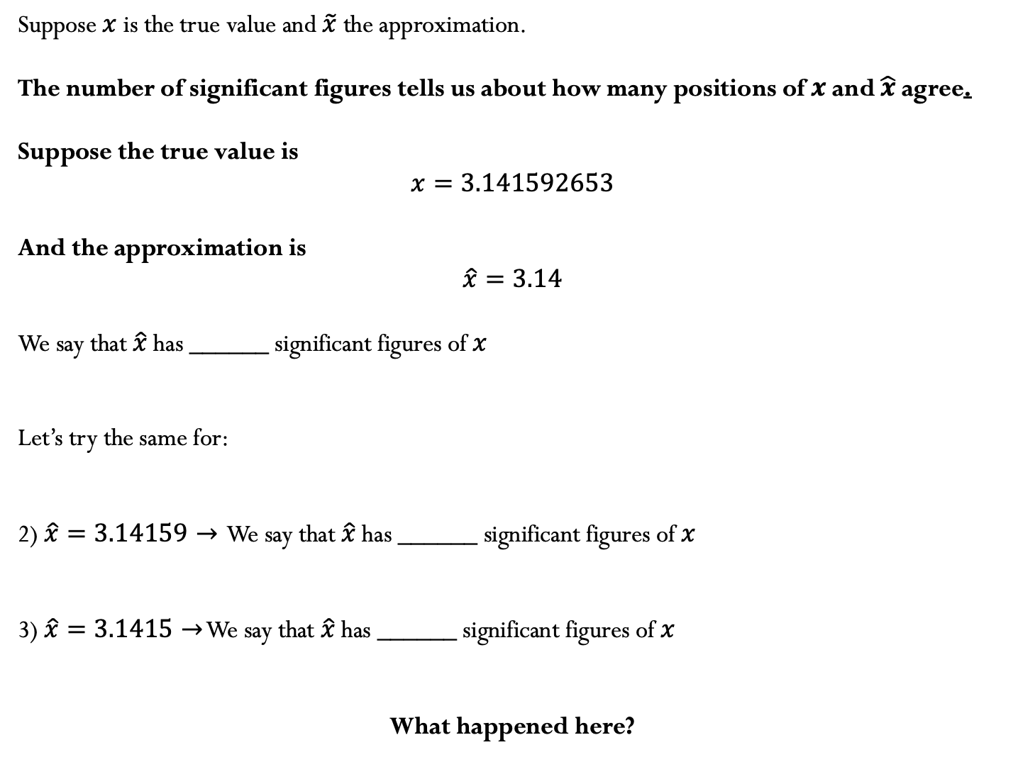
Suppose $x$ is the true value and $\tilde{x}$ the approximation.
The number of significant figures tells us about how many positions of $x$ and $\hat{x}$agree.
Suppose the true value is
$$x=3.141592653$$
And the approximation is
$$\hat{x}=3.14$$
We say that $\hat{x}$ has ______ significant figures of $x$
Let’s try the same for:
2) $\hat{x}=3.14159→$ We say that $\hat{x}$ has ______ significant figures of $x$
3) $\hat{x}=3.1415→$ We say that $\hat{x}$ has ______ significant figures of $x$
What happened here?

Slide 10
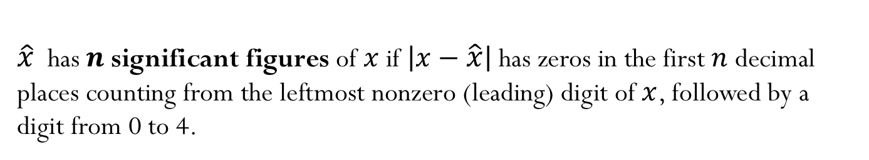
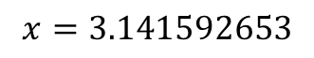
$\hat{x}$ has $n$ significant figures of $x$if $\left|x−\hat{x}\right|$has zeros in the first $n$ decimal places counting from the leftmost nonzero (leading) digit of $x$, followed by a digit from 0 to 4.
$$x=3.141592653$$
$$\hat{x}=3.14159⟶\left|x−\hat{x}\right|=0.000002653$$
$$\hat{x}=3.1415⟶\left|x−\hat{x}\right|=0.000092653$$
$$\hat{x} =3.1416⟶\left|x−\hat{x}\right|=0.000007347$$

Slide 11
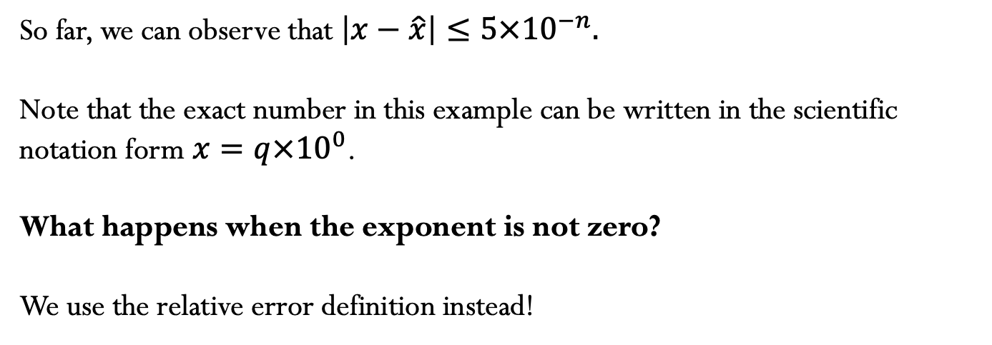
So far, we can observe that $\left|x−\hat{x}\right|≤5×{10}^{−n}.$
Note that the exact number in this example can be written in the scientific notation form $x=q×{10}^{0}$.
What happens when the exponent is not zero?
We use the relative error definition instead!

Slide 12
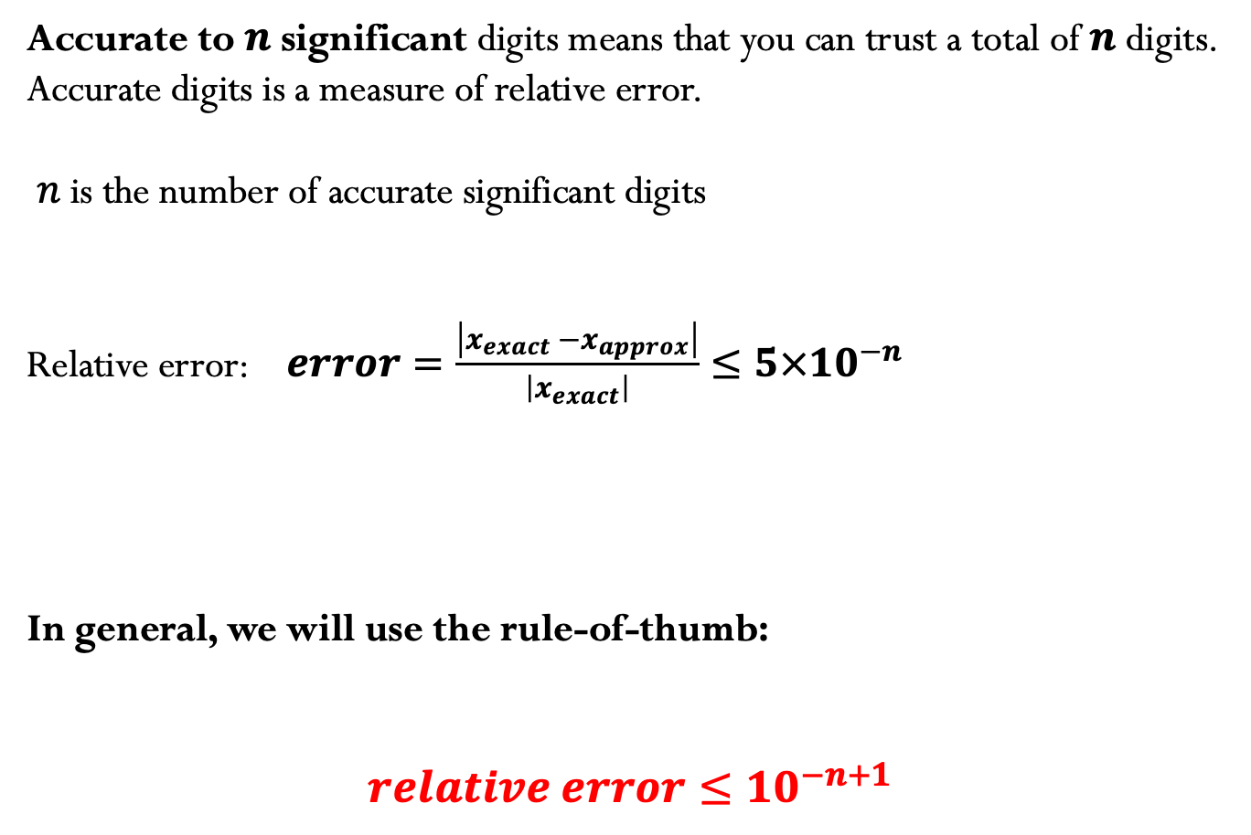
Accurate to $n$ significant digits means that you can trust a total of $n$ digits. Accurate digits is a measure of relative error.
$n$ is the number of accurate significant digits
Relative error: $error=\frac{\left|x_{exact} −x_{approx}\right|}{\left|x_{exact}\right|}≤5×{10}^{−n}$
In general, we will use the rule-of-thumb:
$$relative error≤{10}^{−n+1}$$

Slide 13

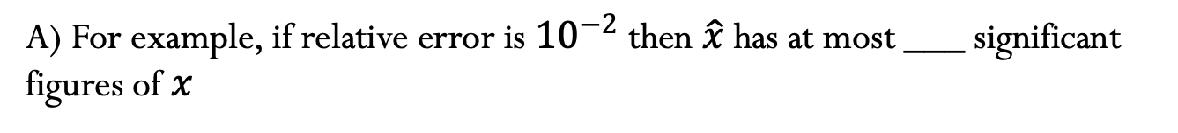
Rule-of-thumb:
$$relative error≤{10}^{−n+1}$$
A) For example, if relative error is ${10}^{−2}$ then $\hat{x}$has at most ___ significant figures of $x$
B) After rounding, the resulting number has 5 accurate digits. What is the tightest estimate of the upper bound on my relative error?

Slide 14
Video 3: Understanding Plots

Slide 15
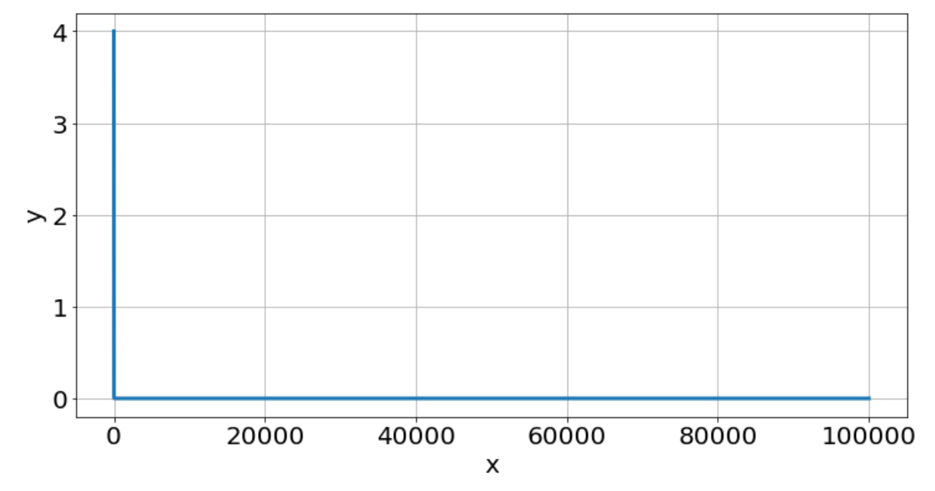
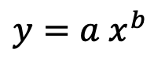
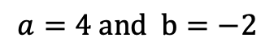
Power functions:
$$y={a x}^{b }$$
$$a=4 and b=−2$$

Slide 16
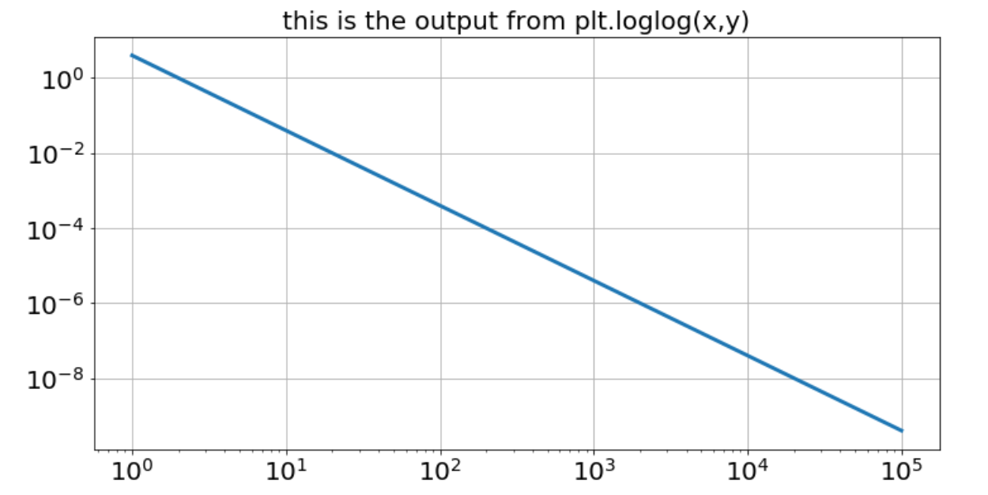
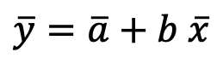
Power functions:
$$y={a x}^{b }$$
$$\overline{y}=\overline{a}+b \overline{x}$$

Slide 17
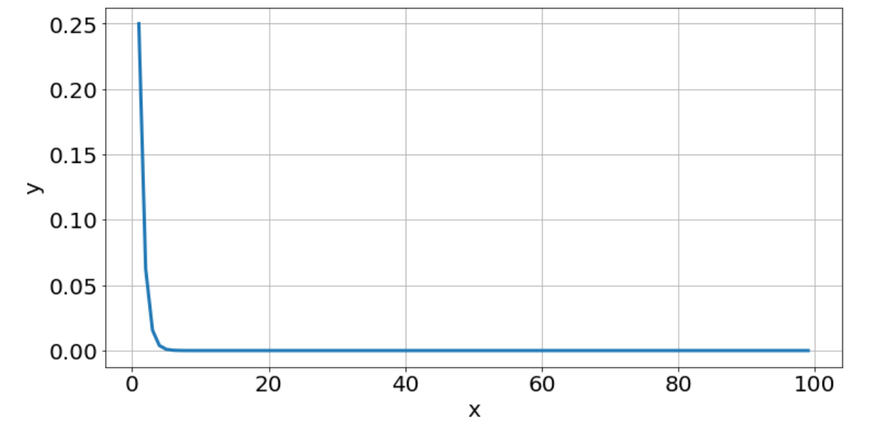
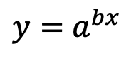
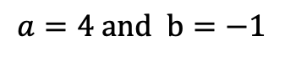
Exponential functions:
$$y={ a}^{bx }$$
$$a=4 and b=−1$$

Slide 18
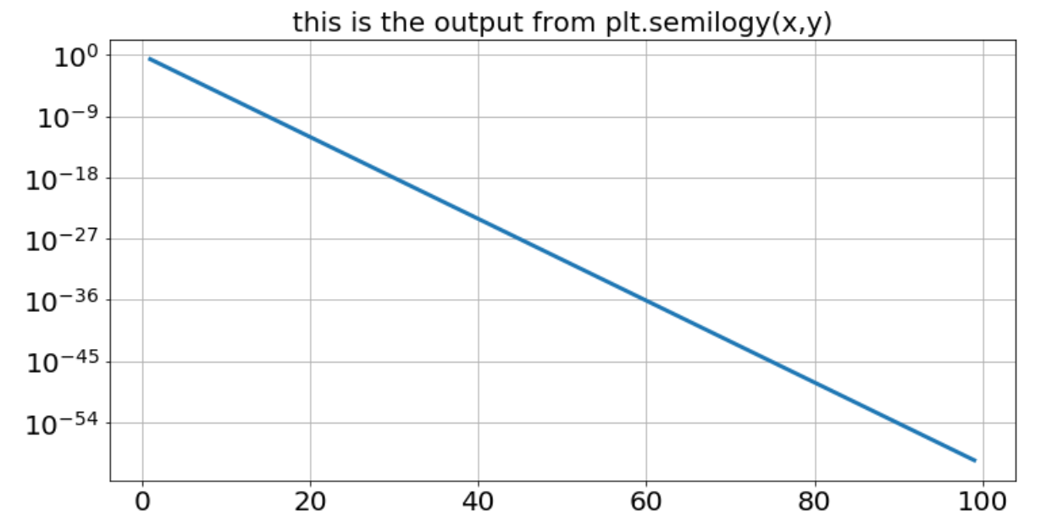
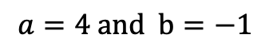
Exponential functions:
$$y={ a}^{bx }$$
$$a=4 and b=−1$$

Slide 19
Video 4: Big-O notation

Slide 20
Complexity: Matrix-matrix multiplication
For a matrix with dimensions $n × n$, the computational complexity can be represented by a power function:
$$time={c n}^{a }$$
We could count the total number of operations to determine the value of the constants above, but instead, we will get an estimate using a numerical experiment where we perform several matrix-matrix multiplications for vary matrix sizes, and store the time to take to perform the operation.

Slide 21
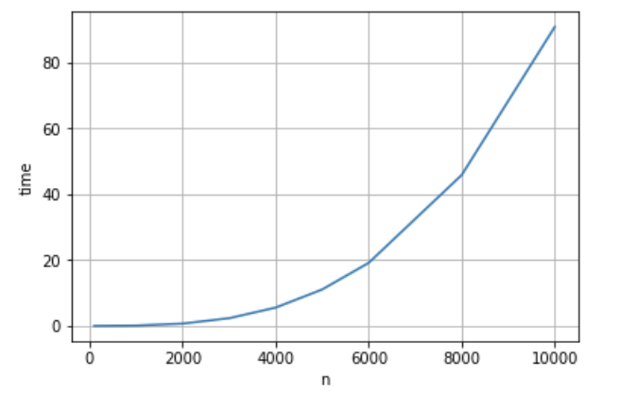
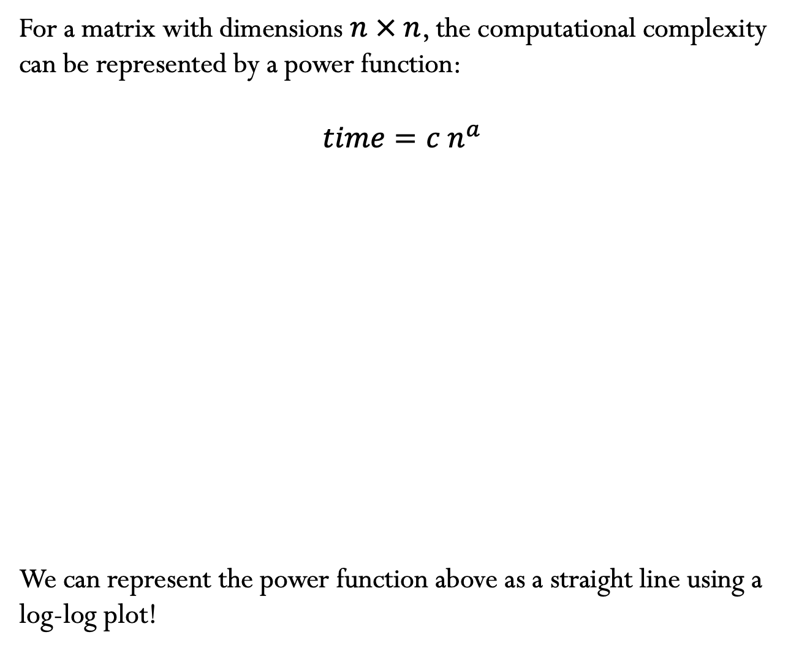
For a matrix with dimensions $n × n$, the computational complexity can be represented by a power function:
$$time={c n}^{a }$$
We can represent the power function above as a straight line using a log-log plot!

Slide 22
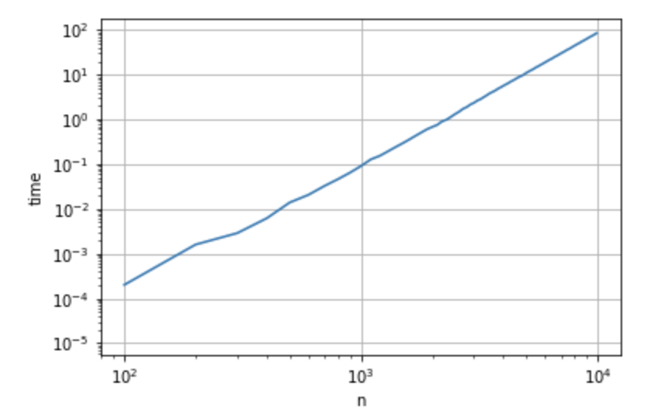
Power functions are represented by straight lines in a log-log plot, where the coefficient $a$ is determined by the slope of the line.
$$time={c n}^{a }$$

Slide 23
Instead of predicting time using $time={c n}^{a }$, we can use the big-O notation to write
$$time={O(n}^{a })$$
where $a$ can be obtained from the slope of the straight line.
For a matrix-matrix multiplication, what is the value of $a$?

Slide 24
We can also get the complexity by counting the number of operations needed to perform the computation:

Slide 25
Big-Oh notation
Let $f$and $g$ be two functions. Then
$f\left(x\right)=O\left(g\left(x\right)\right)$ as $x→∞$
If an only if there is a positive constant M such that for all sufficiently large values of $x$, the absolute value of $f\left(x\right)$ is at most multiplied by the absolute value of $g\left(x\right)$. In other words, there exists a value $M$and some $x_{0}$such that:
$$\left|f\left(x\right)\right|≤M \left|g\left(x\right)\right| ∀ x≥x_{0}$$
Notes:
if and only if there is a positive constant M such that for all sufficiently large values of x, the absolute value of f(x) is at most Mmultiplied by the absolute value of g(x).

Slide 26
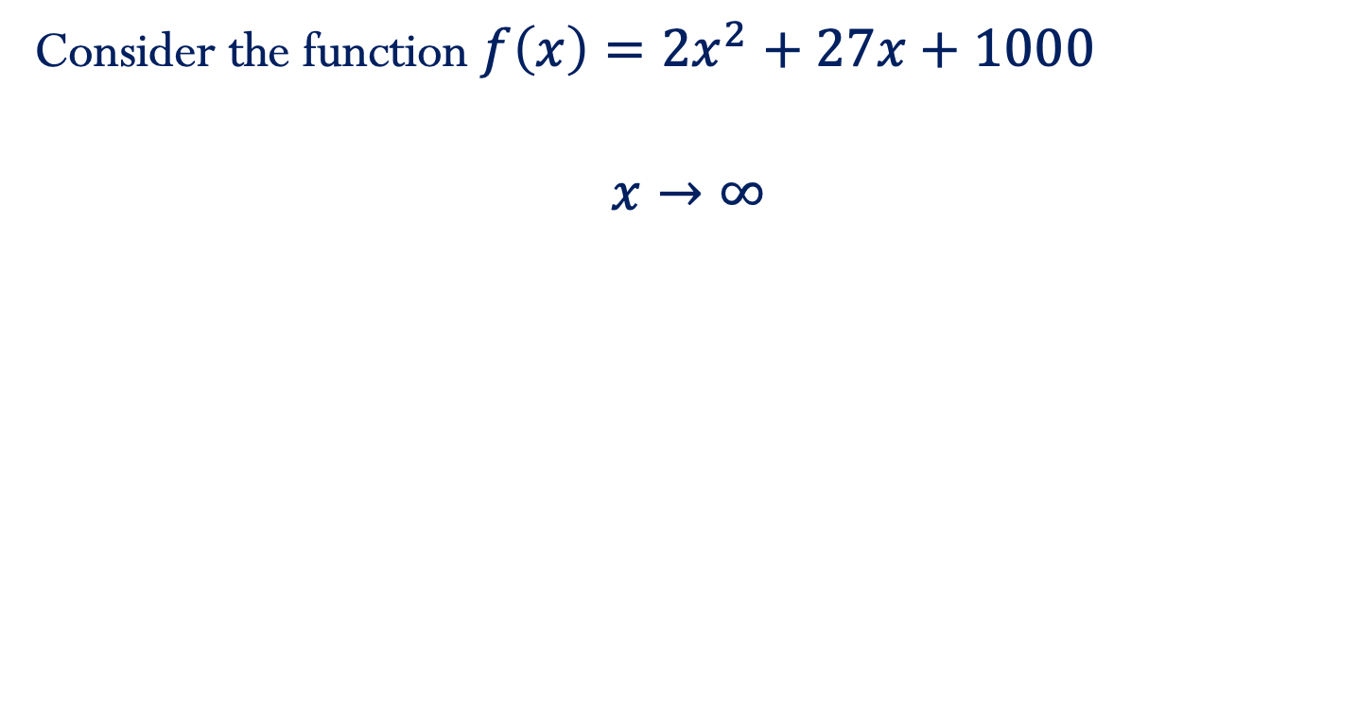
Example:
Consider the function $f\left(x\right)=2x^{2}+27x+1000$
$$x→∞$$

Slide 27
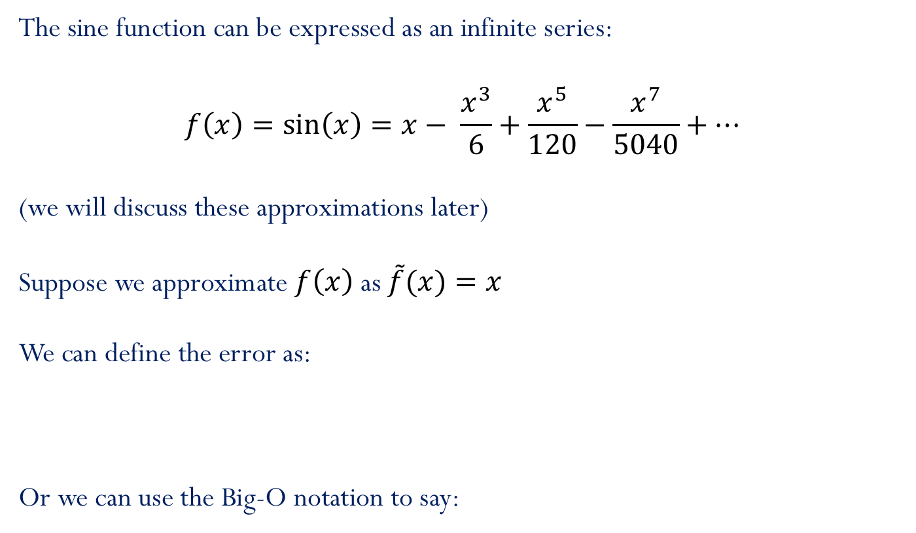
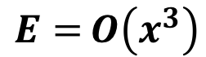
Accuracy: approximating sine function
The sine function can be expressed as an infinite series:
$$f\left(x\right)=\sin\left(x\right)=x− \frac{x^{3}}{6}+\frac{x^{5}}{120}−\frac{x^{7}}{5040}+…$$
(we will discuss these approximations later)
Suppose we approximate $f\left(x\right)$ as $\tilde{f}(x){=x}$
We can define the error as:
Or we can use the Big-O notation to say:
$$E=\left|f\left(x\right)−\tilde{f}(x)\right|=\left|−\frac{x^{3}}{6}+\frac{x^{5}}{120}−\frac{x^{7}}{5040}+…\right|$$
$$E={O\left(x^{3}\right)}$$

Slide 28
Big-Oh notation (continue)
Let $f$and $g$ be two functions. Then
$f\left(x\right)=O\left(g\left(x\right)\right)$ as $x→a$
If an only if there exists a value $M$and some $δ$ such that:
$$\left|f\left(x\right)\right|≤M \left|g\left(x\right)\right| ∀x where 0<|x−a|<δ$$

Slide 29

Same example…
Consider the function $f\left(x\right)=2x^{2}+27x+1000$
$$x→0$$

Slide 30
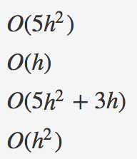
Iclicker question
Suppose that the truncation error of a numerical method is given by the following function:
$$E\left(h\right)=5h^{2}+3h$$
Which of the following functions are Oh-estimates of $E\left(h\right)$ as $h→0$
1)
2)
3)
4)

Slide 31
Iclicker question
Suppose that the complexity of a numerical method is given by the following function:
$$c\left(n\right)=5n^{2}+3n$$
Which of the following functions are Oh-estimates of $c\left(n\right)$ as $n→∞$
1)$O(5n^{2}+3n)$
2) $O(n^{2})$
3) $O(n^{3})$
4) $O(n)$

Slide 32
Video 5: Making predictions

Slide 33
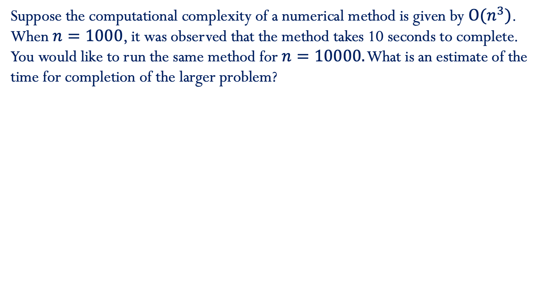
Suppose the computational complexity of a numerical method is given by $O{(n}^{3})$. When $n=1000$, it was observed that the method takes 10 seconds to complete. You would like to run the same method for $n=10000.$ What is an estimate of the time for completion of the larger problem?
Check the course notes: Error - BigO Role of Constants

Slide 34
Video 6: Rates of convergence

Slide 35
Rates of convergence
$$error\sim \frac{1}{n^{α}}$$
or$O\left(\frac{1}{n^{α}}\right)$
1) Algebraic convergence:
Algebraic growth:
$$time\sim n^{α}$$
or$O\left(n^{α}\right)$
$α:$ Algebraic index of convergence
A sequence that grows or converges algebraically is a straight line in a log-log plot.
Demo “Exponential, Algebraic and Geometric convergence”

Slide 36
Rates of convergence
2) Exponential convergence:
$$error\sim e^{−αn}$$
or$O\left(e^{−αn}\right)$
Exponential growth:
$$time\sim e^{αn}$$
or$O\left(e^{αn}\right)$
A sequence that grows or converges exponentially is a straight line in a linear-log plot.

Slide 37
Rates of convergence
Exponential growth/convergence is much faster than algebraic growth/convergence.

